Slide 1
Machine learning to unveil the fluid structure interaction of air-backed impact
Dynamical Systems Laboratory
New York University Tandon School of Engineering, Brooklyn, NY
Simon Carrillo Segura | Akhilesh Kapse
o9 July 2021

Slide 2
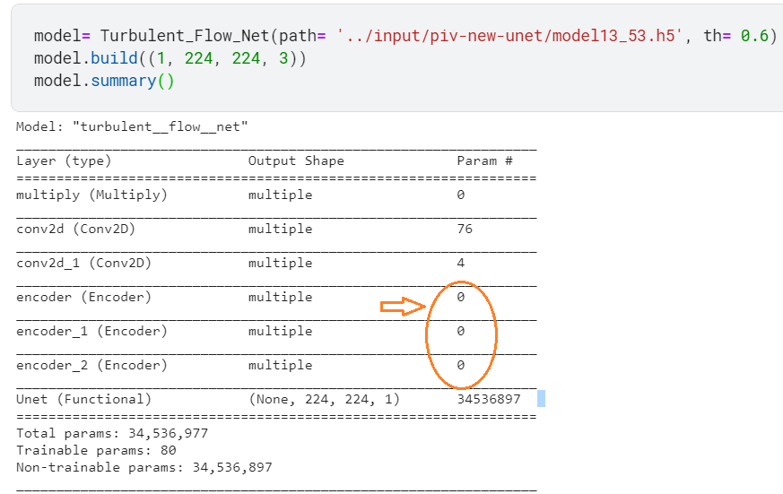
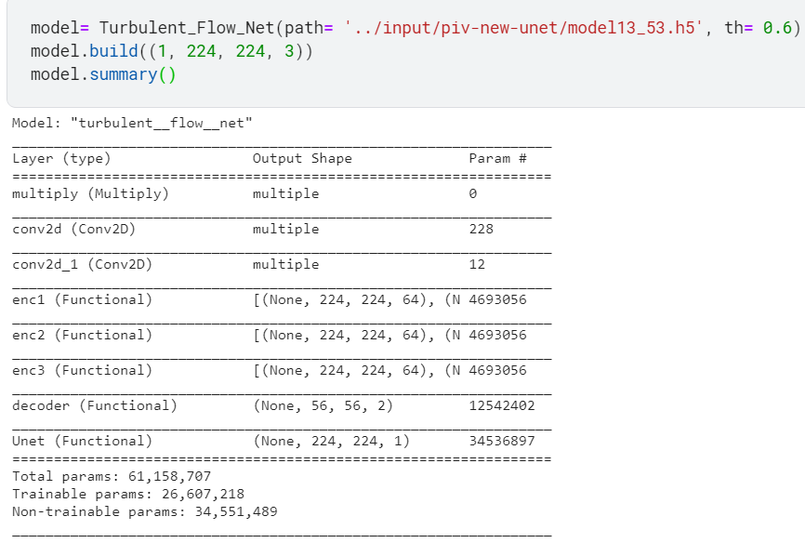
Turbulent Flow Net
Old version
New version
Revised the code and data from scratch.
Fixed error in the model making part.
Exploratory data analysis of our input data.

Slide 3
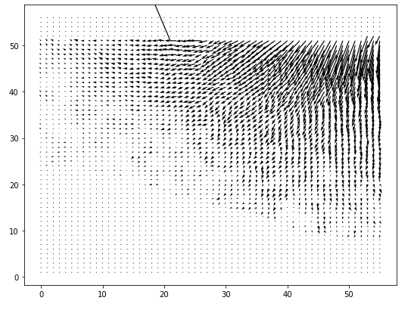
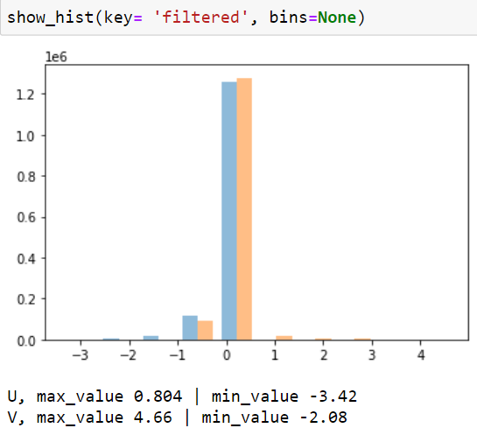
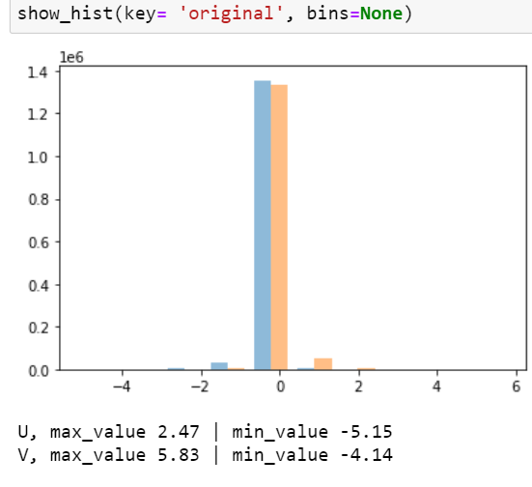
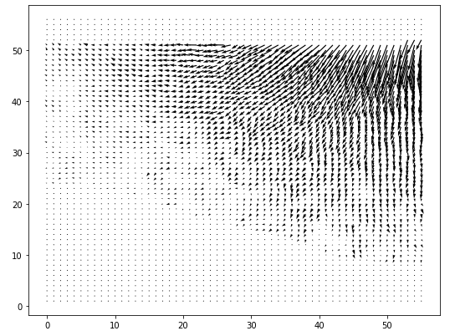
Input EDA
u,v (original)
2 sub-data file in .MAT file.
U,V (original) and U,V (filtered).
Difference in data (Standard deviation) and Outliers.
u,v (filtered)

Slide 4
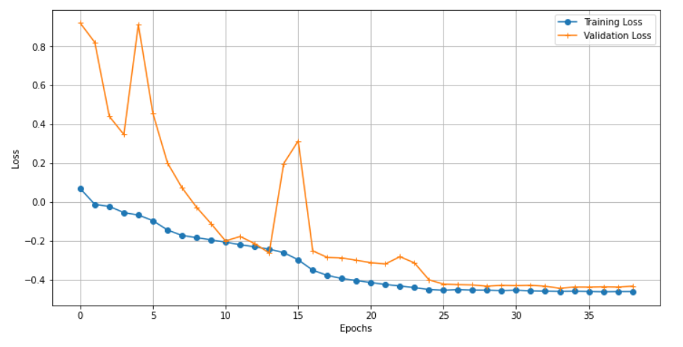
Loss
Re-define the loss function-
Mean squared error + Cosine Similarity

Slide 5
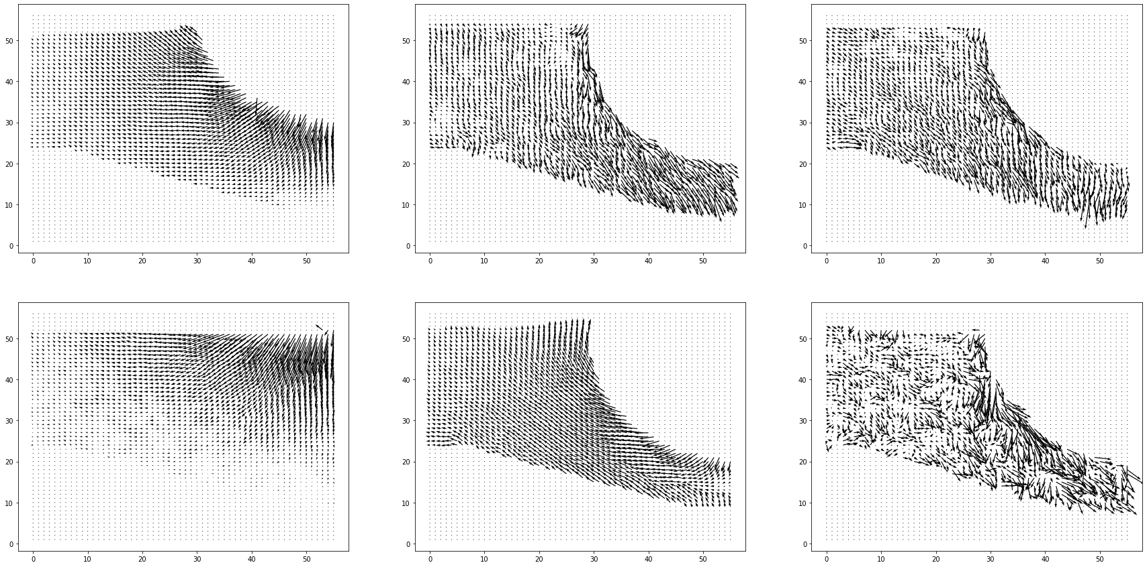
Results
Ground Truth

Slide 6
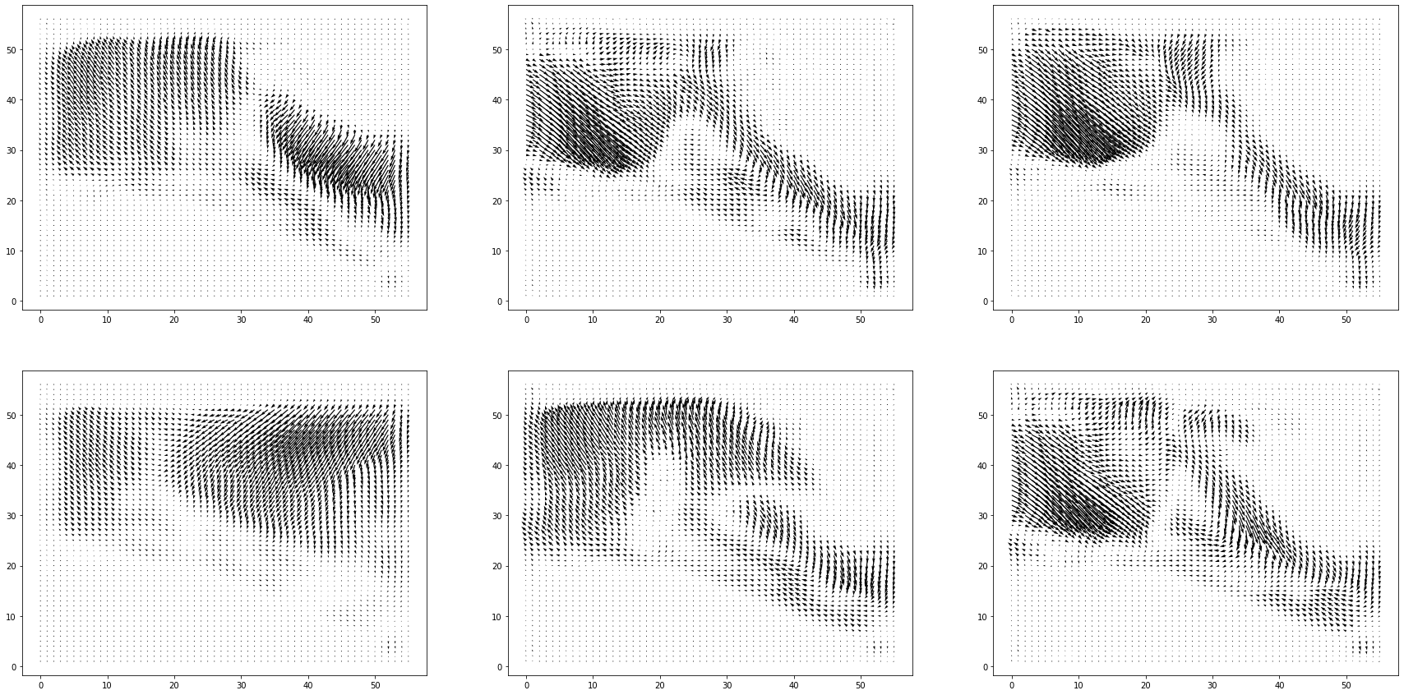
Results
Predicted

Slide 7
Future work
Try out the sequential data for training the model: input will be two or three image, instead of an individual image.
This can be seen as giving past, present and future information to the neural network. The neural network will learn from the relationship between those three input images.
Thank You!

